Slide 1


AI/Machine Learning in Fintech

Slide 2


Contents
AI /Machine learning in digital lending startups
Competitor landscape
Insights

Slide 3
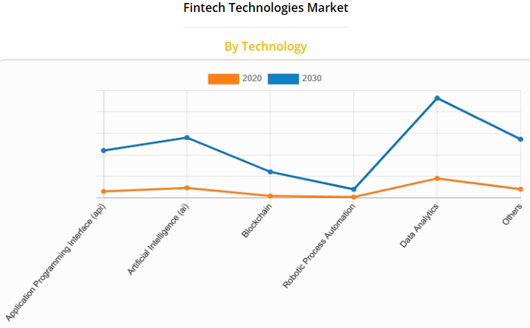
AI/Machine learning in digital lending startups
Digital lending is one of the fastest-growing fintech segments in India with a CAGR of 39.5%.
Today, many companies in this industry use AI by leveraging its ability to process, analyze, and make sense of vast amounts of data in real time thus making loan processing more accurate, reliable, and faster.
AI's predictive capability aids in seamlessly analyzing borrowers’ financial behaviour.
This substantially reduces the barriers to entry for startups. Most of these startups are scaling very fast.
Source: Allied Market Research - Financial technologies market outlook - 2030
"India being a perpetually credit-deficient society, innovative lending solutions present a relatively easier play for personal needs and corporate lending," - Ashwani Singh, Managing partner, 35 North Ventures India Discovery Fund.

Slide 4
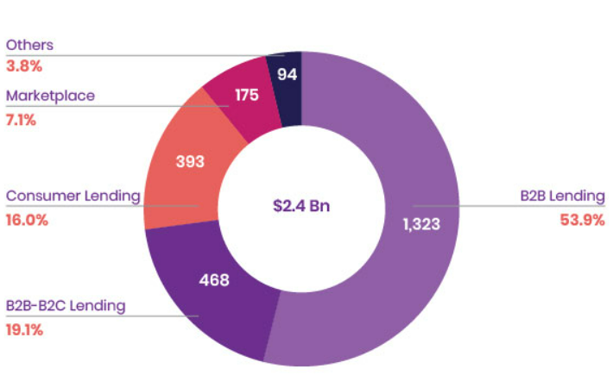
Competitor Landscape
B2b Lending | B2b+B2c lending | B2C lending | P2P Lending | Marketing | Lending Saas
AYE | LoanTap | Rupeek | Faircent | Bankbazaar | Perfios
Lendingkart | InCred | Kissht | Finzy | Paisabazaar | Creditvidya
Okcredit | Capital float | Zest | Lenden | Creditmantri | Skeps
Moneytap | Finwego | Paysense | I-lend | Loanadda | Creditsundaar
Kinara | Finreq | Better.com | Lendbox | Loanbaba
Insights
One of the catalysts for the use of AI in lending is the launch of the Account Aggregator (AA) framework which offers a unified view of customer financial data.
Further, the impact of generative AI in credit risk assessment, process streamlining, fraud detection, and real-time decision-making on business lending will be far-reaching.
The future will lead to more customizable products created for individuals based on their requirements and enhanced customer experience-oriented.
India’s digital lending market was worth $ 270 bn in 2022 and is expected to reach $ 350 bn by 2023.

Slide 5


Thank you!

